Slide 1

Università degli Studi di Milano
Statistical Learning
Danial Forouzanfar - 12988A

Slide 2
Supervised:
Decision Tree,
Random Forest,
eXtreme Gradient Boosting

Slide 3
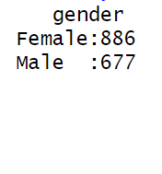
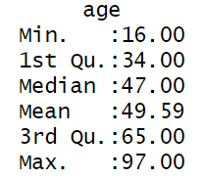
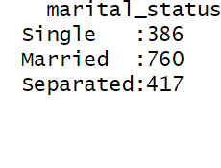
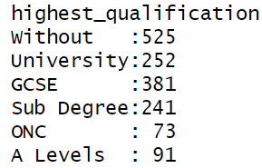
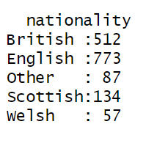
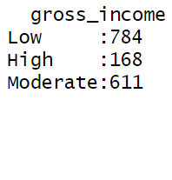
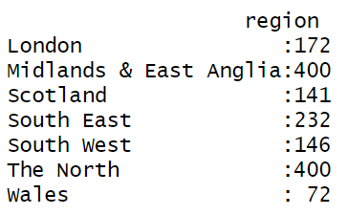
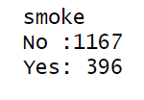
Data on smoking habits

Slide 4
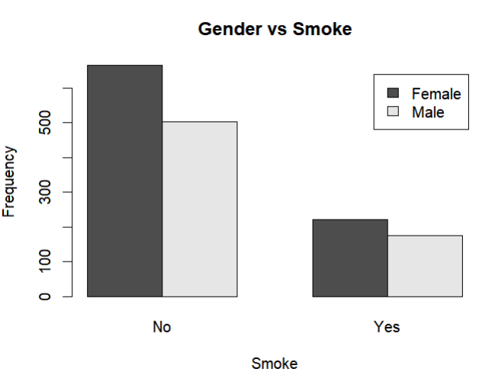
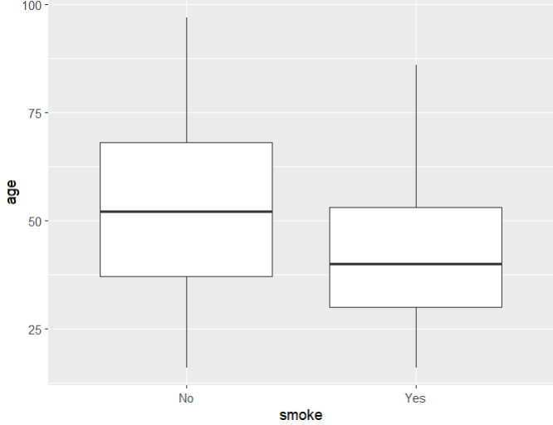
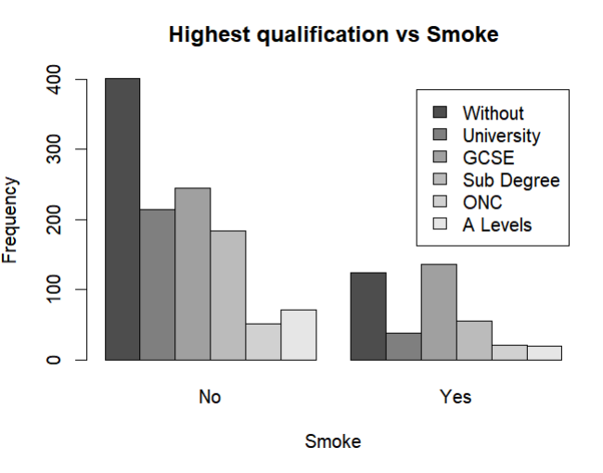
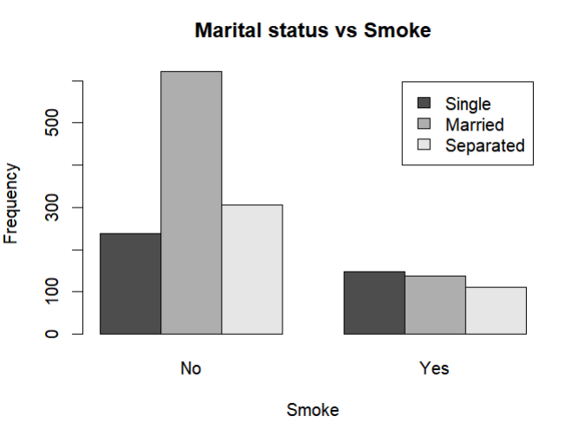

Slide 5
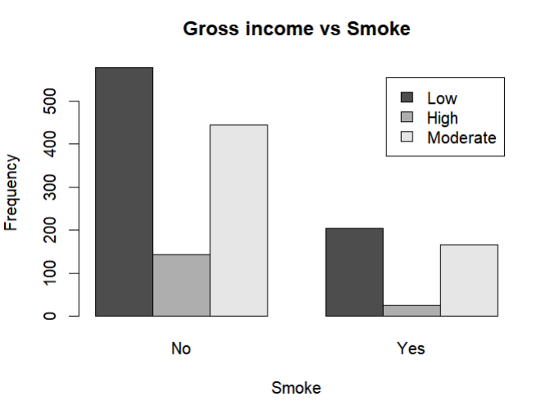
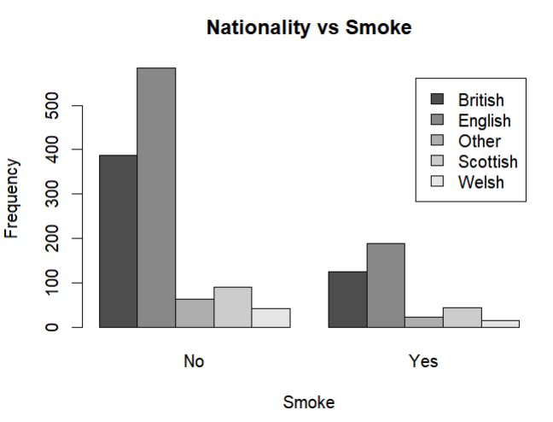
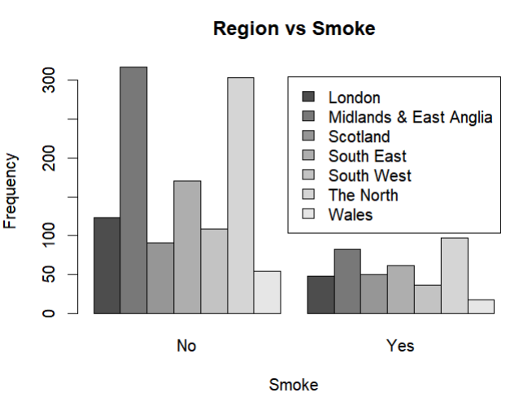

Slide 6
Libraries
General
Decision Tree
Random Forest
tidymodels
visNetwork
randomForest
tidyverse
rpart
e1071
caret
XG Boosting
xgboost
rattle

Slide 7
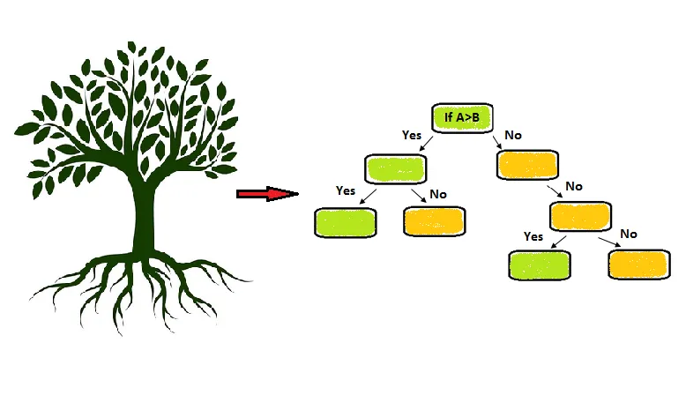
Decision Tree

Slide 8
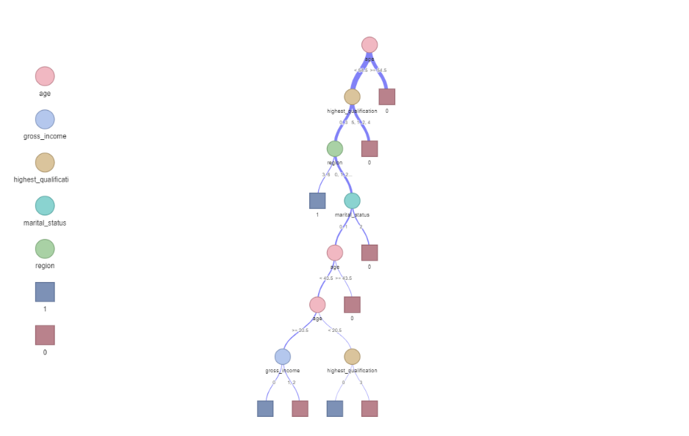
Decision Tree

Slide 9
Decision Tree
 | Metric | Value
1 | Accuracy | 0.7468085
2 | Precision | 0.9259259
3 | Recall | 0.7775120
4 | F1 score | 0.8452536

Slide 10
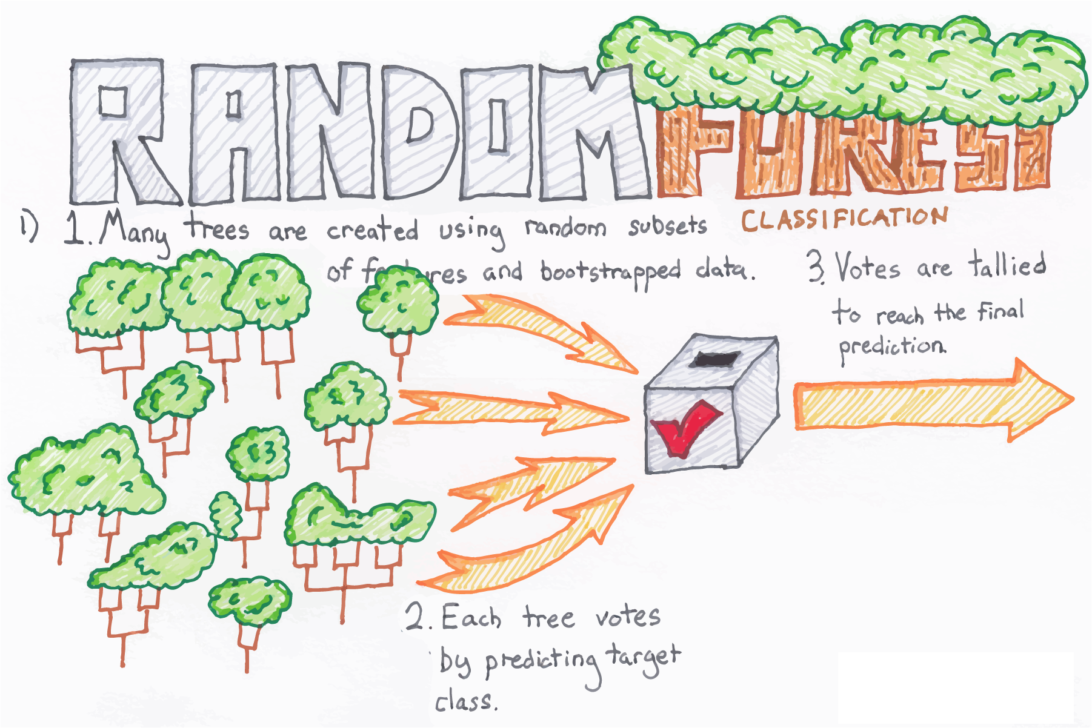

Slide 11
Random Forest
 | Metric | Value
1 | Accuracy | 0.7510638
2 | Precision | 0.9572650
3 | Recall | 0.7671233
4 | F1 score | 0.8817110

Slide 12
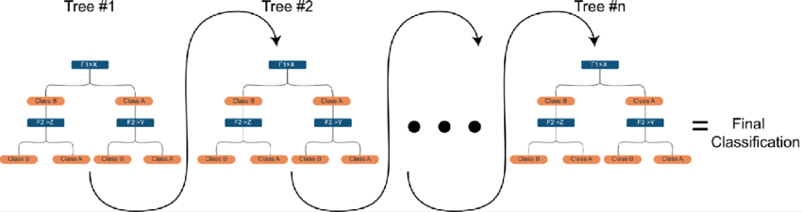
eXtreme Gradient Boosting

Slide 13
XG Boosting
 | Metric | Value
1 | Accuracy | 0.7595745
2 | Precision | 0.9743590
3 | Recall | 0.7668161
4 | F1 score | 0.8582183

Slide 14
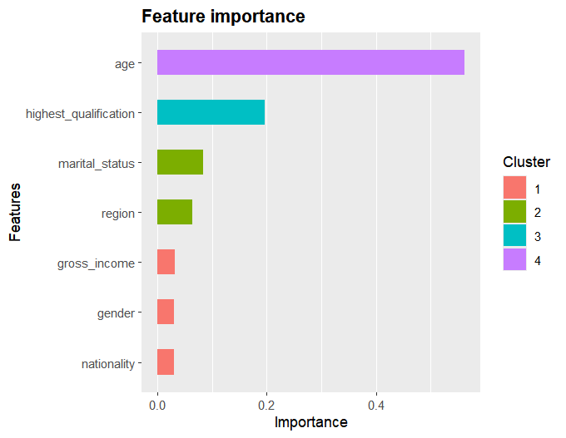

Slide 15
Unsupervised:
PCA

Slide 16
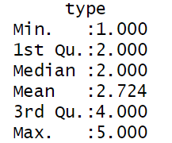
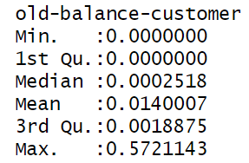
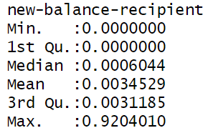
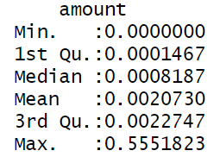
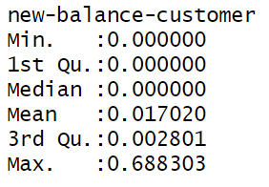
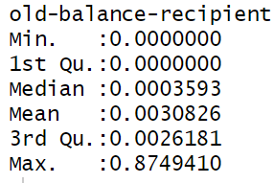
Fraud Detection

Slide 17
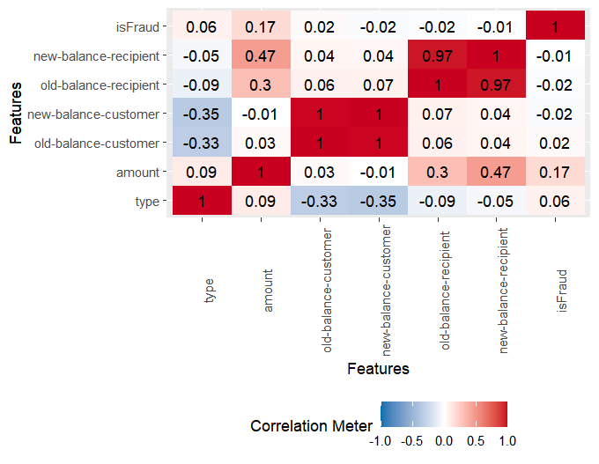

Slide 18
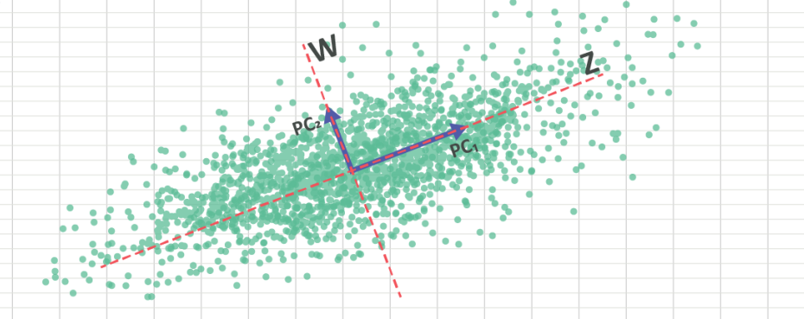
PCA

Slide 19
PCA
PCA
Method | Randomized
Transform | Standardize
K | 2
Threshold Level | 15

Slide 20
PCA
Eigen Values
Var | PC1 | PC2
Type | -0.261 | -0.274
Amount | 0.270 | -0.315
Old-Balance-Customer | 0.440 | 0.480
New-Balance-Customer | 0.438 | 0.487
Old-Balance-Recipient | 0.484 | -0.402
New-Balance-Recipient | 0.489 | -0.444

Slide 21
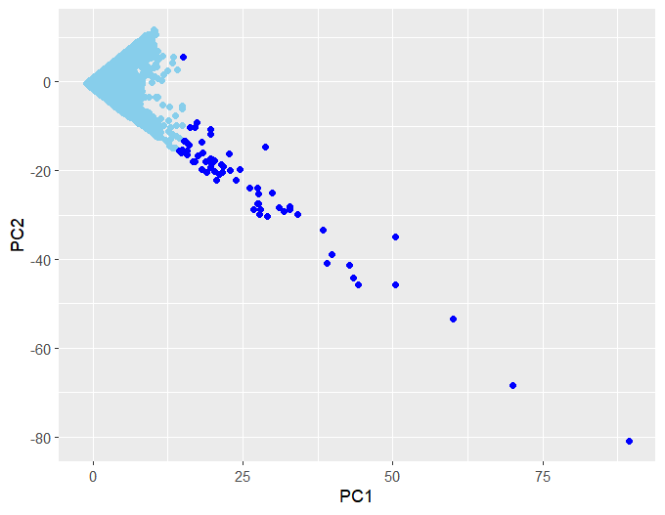
PCA

